Slide 1
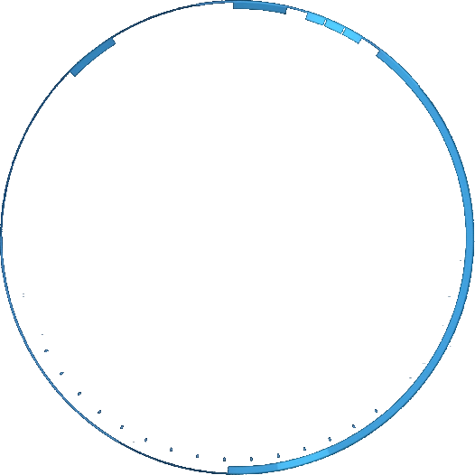

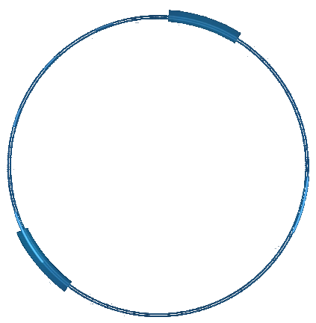





Iteration III
4 amigos
Group members:
Yangzekun Gao
Jingke Shi
Zhengyan Hu
Maiqi Hou

Slide 2
Catalog
1
Project Vision
GIT
2
Show APP
3
4
Gantt / Time-Card / Issue tracking

Slide 3
01
Project Vision
Our team has developed an accounting software. Users can record their daily expenses and income. They can perform a series of operations on their records at the same time. This software contains the following functions.
Add: add new expenses or income records
View: view historical records
Delete: delete a record from the database
Export: export the records of specified month

Slide 4
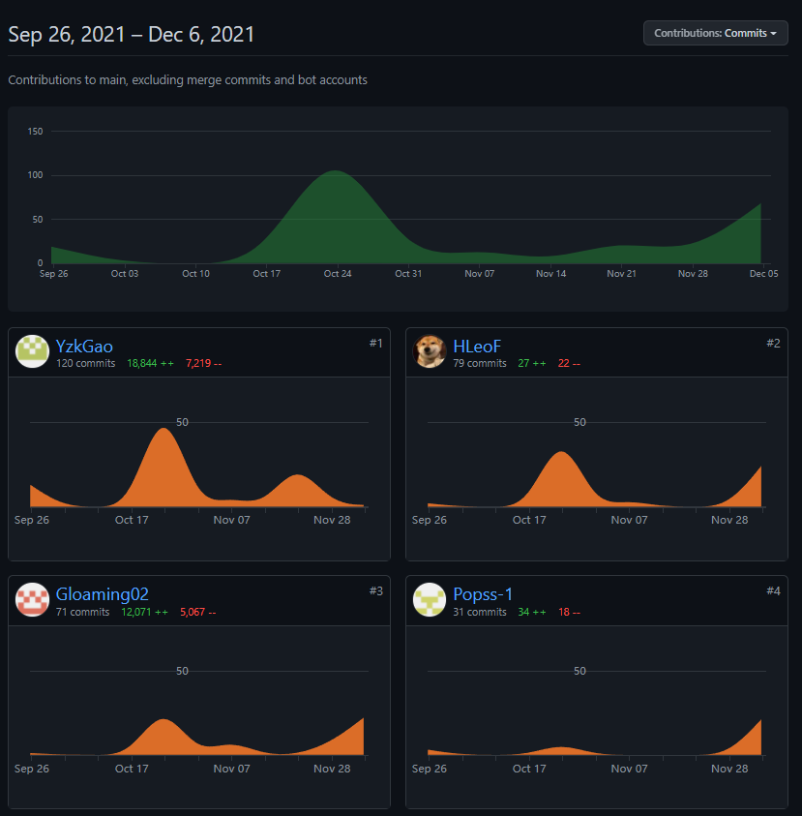
02
GIT
Total Commits: 301
Yangzekun Gao: 120
Jingke Shi: 31
Zhengyan Hu: 71
Maiqi Hou: 79

Slide 5

03
Show APP

Slide 6
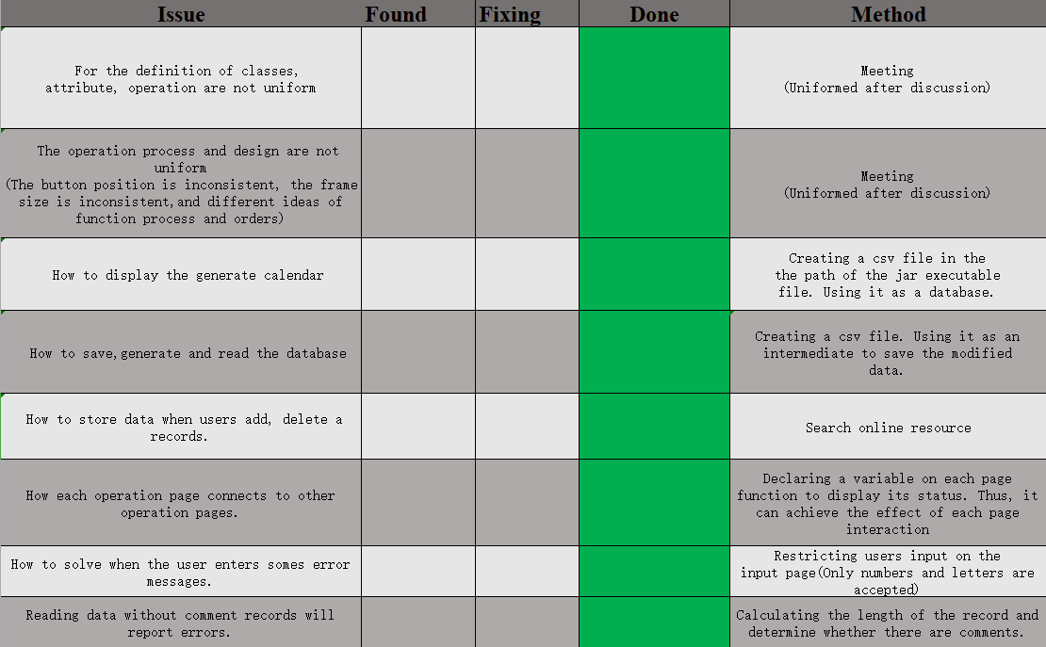
04
Gantt / Time-Card / Issue tracking
Issue tracking

Slide 7
04
Gantt / Time-Card / Issue tracking
Meetings:
Sunday, October 24, 2021 (5 PM – 7 PM)
Wednesday, October 27, 2021 (1:25 PM – 6 PM)
Friday, October 29, 2021(2:30 PM – 7Pm)
Friday, November 5, 2021(5:30 PM – 7Pm)
Monday, December 6, 2021(2:30 PM – 7Pm)
Individual Hours:
Yangzekun Gao: 10 + 9.25 + 5 +25= 49.25 hrs.
Maiqi Hou: 9 + 8.75 + 5 +20= 43.75hrs.
Jingke Shi: 9+ 8.0 + 2 +20.5 = 40.5 hrs.
Zhengyan Hu: 9 + 7.25 + 5 +20 = 41.25 hrs.
Time - Card

Slide 8
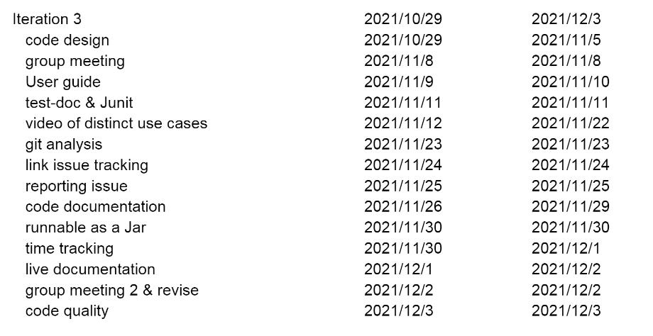
04
Gantt / Time-Card / Issue tracking

Slide 9
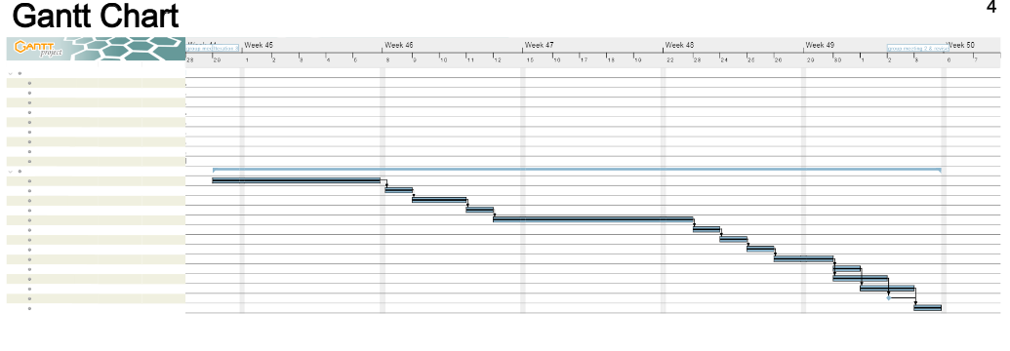
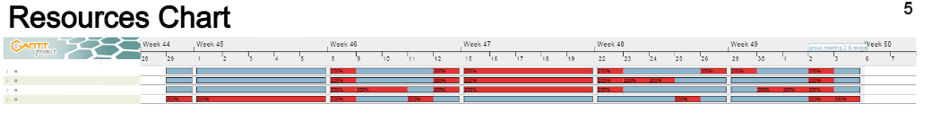
04
Gantt / Time-Card / Issue tracking

Slide 10
Iteration III
Thank you

